Slide 1
Concerned significant others of people with problematic internet use: Identifying dimensions to include in their assessment
Francine Ferland, Joël Tremblay and Caroline Thériault
francine.ferland.ciussscn@ssss.gouv.qc.ca / joel.tremblay@uqtr.ca
Addiction and the Family International Network (AFINet)
Webinar Series – 22 November 2024

Slide 2
Presenters
Francine Ferland, Ph.D
Addiction Research Service, CIUSSS de la Capitale-Nationale and CISSS de Chaudière-Appalaches
Joël Tremblay, Ph.D.
Professor in the Department of Psychoeducation of the Université du Québec à Trois-Rivières and scientific director of the RISQ
Caroline Thériault, M.Sc.
Doctorate student in Psychoeducation, Laval University

Slide 3
Context
There were 5.52 billion internet users worldwide in October 2024¹
Representing 67.5 percent of the global population
The presence of Internet introduced many positive changes into the daily activities
However, some people are making and excessive use of this new technology and might develop an addiction actually called
Problematic Internet Use (PIU)
1. https://www.statista.com/statistics/617136/digital-population-worldwide/#:~:text=Worldwide%20digital%20population%202024&text=As%20of%20October%202024%2C%20there,percent%20of%20the%20global%20population

Slide 4
Context
Prevalence of PIU ²
Adolescents: between 0.8% in Italy and 26.6% in Hong Kong
Adults: between 1% (Norway) and 22.8% (Iran)
2. Kuss, D.J., Griffiths, M.D., Karila, L., & Bilieux, J. (2014). Internet addiction: a review of epidemiological research for the last decade. Current Pharmalogical Design,20, 4026–4052. DOI: 10.2174/13816128113199990617

Slide 5
Context
PIU has become a serious public health issue
Actual studies focus mainly on:
Few studies have taken into consideration the concerned significant others (CSOs) of people with PIU
Definition of PIU | Risk factors
Assessment | Treatment
Comorbidities | Consequences

Slide 6
Context
As other addictions or excessive use, PIU could have impacts on CSO
Impact relationship
Creates conflicts ensuing from screen use
Creates a feeling of missing out
Creates couple difficulties such as conflicts, separation, and divorce

Slide 7
Goal of the presentation
Document the impacts faced by CSOs in order to target the dimensions that should be included in the assessment of their service needs

Slide 8
Method
Scoping review: Researching journal articles in 4 databases
Inclusion criteria
Article mentions at least once that a person in the family or couple displayed PIU
CSOs’ view is directly reported either through questionnaires or interviews
Article describes an intervention program or questionnaire intended for CSOs
Articles had to be published between 2000 and 2019 and written in English or French

Slide 9
Method
Keywords targeted 3 dimensions
Problematic Internet Use
Program/Test/Therapy
Concerned significant others
3,541 articles were found with the selected keywords
After removing repeats, reading titles and abstract
6 articles were conserved for the review

Slide 10
Method
Description of the 6 articles
5 addressed the experiences of the partners of online gamers or excessive Internet users
1 focused on the views of parents who participated in a family intervention with their adolescent who displayed problematic smartphone use
0 described questionnaires for CSOs
We will presents results only for the articles that addressed the partners experiences

Slide 11
Results Consequences for concerned significant others
All consequences are associated with the time spent on screens
Communication
Partners report that their spouse’s excessive Internet use is the main reason for reduced communication in the couple

Slide 12
Results Consequences for concerned significant others
Conflicts
According to partners, the excessive time their spouse spends gaming online is the first cause of increased conflicts
Partners also declare that over time, the nature of the conflicts changed and became increasingly focused on the uneven distribution of family roles and responsibilities

Slide 13
Results Consequences for concerned significant others
Distribution of Chores and Responsibilities
The spouse’s excessive use of online games significantly affects the sharing of parental chores and obligations
Spouse neglects responsibilities such as domestic chores and children’s care
Those who have children confirm that their spouse neglects their parenting role, regardless of the children’s age

Slide 14
Results Consequences for concerned significant others
Financial Problems
Losses are directly related to registration fees and the purchase of items for online games
Indirect losses occur due to the gamer’s general neglect of family finances
Ex,: Decrease in wages after taking time off work to play online or to recuperate after spending a night gaming

Slide 15
Results Consequences for concerned significant others
Psychological and Emotional Impacts
Powerlessness, despair, anger, resentment, and feeling of being neglected
Partners’ Perception of their Spouse
PIU negatively affects the partners’ view of their spouse’s self-control
This has a negative impact on the partners’ trust in their spouse

Slide 16
Results Consequences for concerned significant others
Intimacy
Emotional and physical intimacy decrease when the spouse engages in excessive use of online games
Example: gaming spouses go to bed much later, which reduces time for intimacy
Excessive internet use stimulates a feeling of rejection, which then leads to become more distant by reducing their interactions and refusing intimacy

Slide 17
Results Coping strategies to deal with the psychological impacts and daily consequences
Justify the amount of time their spouse spends online by attributing benefits to this activity
Find some comfort in knowing that their spouse’s excessive behavior occurs at home rather than outside of the home
Use Internet forums to talk, exchange ideas, advice and support
Take interest in their spouse’s online activities and begin to play with him/her in order to spend time together

Slide 18
Conclusion
Partners of PIU persons, face many consequences because of the Internet use of their spouse
Those consequences are quite similar to those of what we see in other addiction
As they need support and help, it is important to assess correcty their needs before they start treatment/services

Slide 19
The 6 papers
Gause, N.J. (2014). Compulsive gaming patterns in adult males and their partners: a qualitative generic approach [PhD Dissertation], Cappela University. https://www.proquest.com/openview/dcc03a81b6e40fab357f688805dd90b8/1.pdf?pq-origsite=gscholar&cbl=18750
Kerkhof, P., Finkenauer, C., & Muusses, L.D. (2011). Relational consequences of compulsive Internet use: A longitudinal study among Newlyweds. Human Communication Research, 37, 147–173.
Leong, B.D., Lee, B.Y.H., & Chow, K.K.N. (2018). Collective play versus excessive use: An insight into family-focused design intervention for mobile phone overuse. International Journal of Mental Health and Addiction, 16, 1404–1419.
Lianekhammy, J., & van de Venne, J. (2015). World of Warcraft widows: Spousal perspectives of online gaming and relationship outcomes. American Journal of Family Therapy, 43,454–466.
Muusses, L.D., Finkenauer, C., Kerkhof, P. & Bilieux, J. (2015). Partner effects of compulsive internet use: a self-control account. Communication Research, 42, 365–386.
Northrup, J.C., & Shumway, S. (2014). Gamer widow: A phenomenological study of spouses of online video game addicts. American Journal of Family Therapy, 42, 269–281.

Slide 20
Quebec Addiction Services Assessment – Family Members QASA-FM
The health law that created Quebec’s specialised addiction centers includes services for family members as one of their core missions.
Development of an assessment battery to use at the services entry of family members and friends
Part of:
Development of a full assessment battery in addiction for Quebec
1.4 million Can$ grants
6 years of work
Fall 2025 pilot deployment

Slide 21
QASA-FM
Dimensions to be included in the QASA-FM
Goal of consultation
Improve my well-being
Improve impact on substance/gambling
Protect my family
Type of link (partner, parent, etc.)
Finances/employment
Living arrangments
Quality of social support and Loneliness
Social competence
(WHO-DAS 2.0, social network scale; Inventory of interpersonal problems – IIP but reframed into Interpersonal Strengths)
Quality couple relationship (DAS-4)
Family Functionning (FAD-12)
Parental abilities (Frick et al., 1991, Alabama Parenting Competencies)

Slide 22
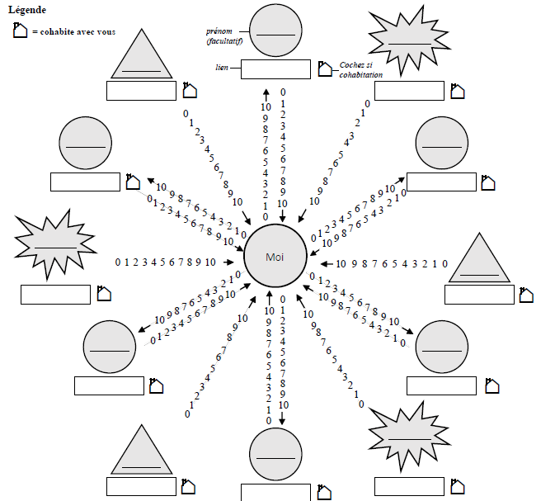
Drawing your social network

Slide 23
QASA-FM
Dimensions to be included in the QASA-FM
Legal situation
Psychological health
Self-esteem
Anxiety, depression/Well-being (WHO-5)
Resilience
Important life events + PTSD/symptômes
The meaning of life / positive view of the future
Gratitude/gratefullness
Physical health (brief)
Strength of cultural belonging
Importance of spirituality

Slide 24
QASA-FM
Dimensions to be included in the QASA-FM
Addiction severity of the loved one
His/her motivation to change
Level of adequacy of the loved one / domains of life
Impact of addiction on the FM
Coping questionnaire (Québec version in validation)
FM perception of addiction (chronicity, relapses, abstinence vs moderate use, roles of family members, attributions, etc.)
Hope, vision of the futur for you and with the loved one with an addiction

Slide 25
Thank you!

